Slide 1
Chapter 10 – The Behavior of Gases

Slide 2
Characteristics of Gases
Substances that are liquids or solids under ordinary conditions may also exist of gases.
Referred to as vapors
Highly compressible
Occupy full volume of their container
When subjected to pressure, volume decreases
Always form homogeneous mixtures with other gases

Slide 3
Occupy a small fraction of the total volume of the container (mostly empty space)
Causes each molecule to behave largely as though other molecules are absent
Exerts pressure on its surroundings
Air = mixture of gases exerting pressure on the earth

Slide 4
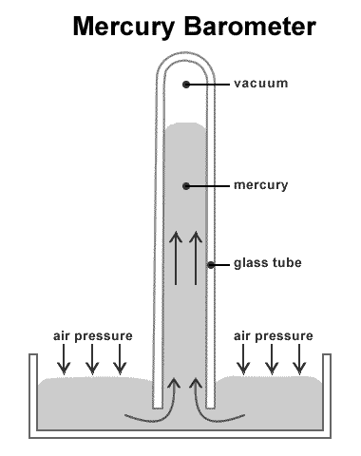
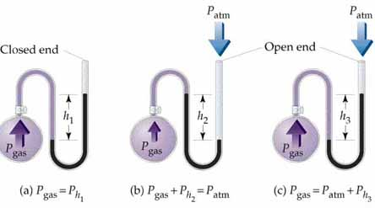
Pressure
Barometer
Measures atmospheric pressure
Invented by Evangelista Torricelli in 1643
Manometer
Measures the pressure of a system

Slide 5
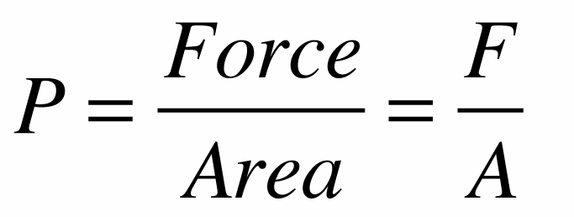
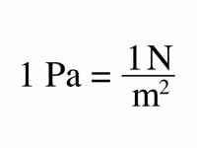
What is Pressure?
Force acting on a object per unit area
SI unit for force is Newtons (N)
Area is measured in meters squared (m²)
SI unit for pressure pascal (Pa)
Standard Pressure
1 atm = 760 mm Hg = 760 torr = 101.325 kPa = 101,325 Pa

Slide 6
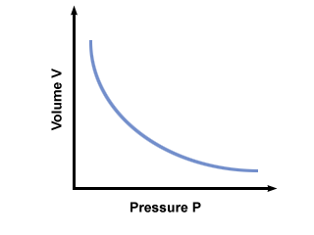
The Gas Laws
Boyle’s Law
PV = k (where k is a constant)
Pressure times volume of a gaseous
system is a constant at T
If either P or V of a gaseous system
at constant T is changed, the other variable will adjust to maintain the constant k
@ T_{c} and n_{c} (constant temperature and # of moles)

Slide 7
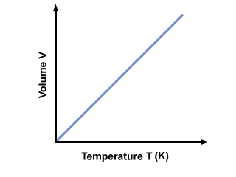
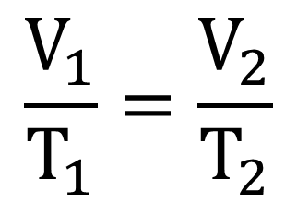
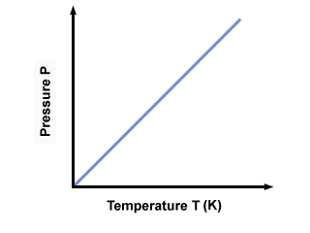
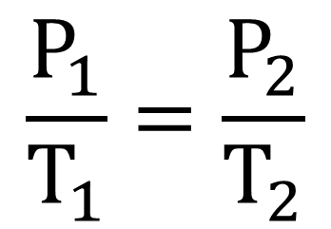
Charles’ Law
Remember,
V/T = k
@ P_{c} and n_{c}
Gay-Lussac’s Law
P/T = k
@ V_{c} and n_{c}

Slide 8
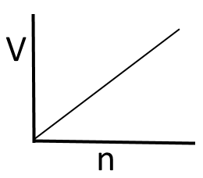
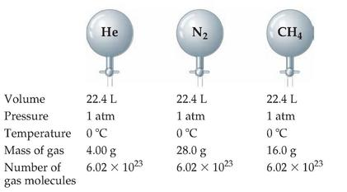
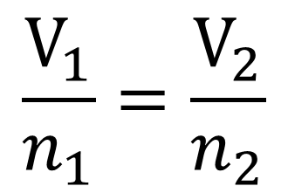
Avogadro’s Law
The volume of a gas at a given
temperature and pressure is directly
proportional to the number of moles
of gas.
V/n = k
Therefore, @ T_{c} and P_{c}

Slide 9
Ideal Gas Law
If we combine all 4 gas laws and keep nothing constant, we can derive the Ideal Gas:
R = universal gas constant
Dependent on the units for Pressure

Slide 10
You have 1 mole of gas @ STP, what volume will it occupy?
STP = standard temperature and pressure (273 K and 1 atm)
Therefore, 1 mole of ANY GAS at STP will occupy
22.4L

Slide 11
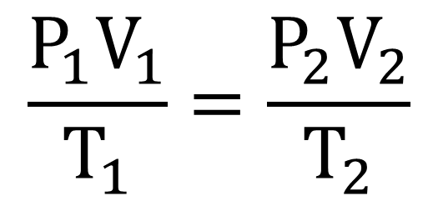
Relating the Ideal Gas Equation and the Gas Laws
If we have a gas under two set conditions, then
Often P, V, and T will change but the number of moles will remain fixed.
For this set of conditions, = constant
Which gives the Combined Gas Law:

Slide 12
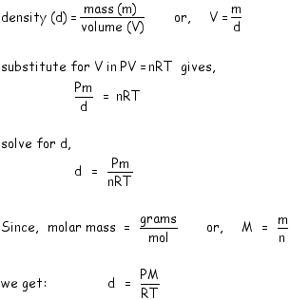
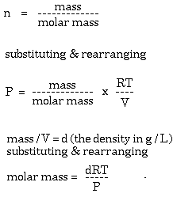
Gas Densities and Molar Mass
Density & Ideal Gas
Molar Mass & Ideal Gas

Slide 13
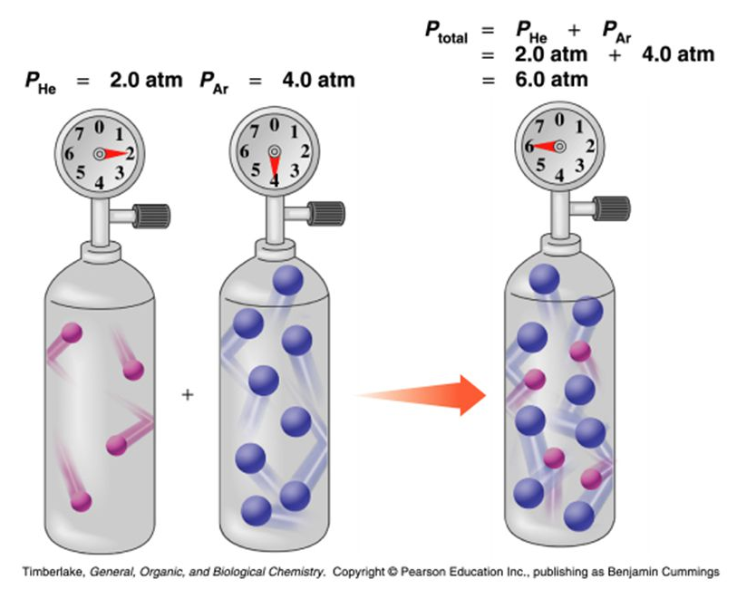
Dalton’s Law of Partial Pressures
For a mixture of gases in a container, the total pressure exerted is the sum of the pressures that each gas would exert if it were alone.

Slide 14
Gases 1, 2, 3… are individual gases and each obey the ideal gas law meaning:
Since all gases are in the same volume and at the same temperature:
What’s so significant here is that the total number of gas particles is what matters, not which gases they are.
ALL ideal gases behave the SAME under the SAME conditions!

Slide 15
Partial Pressures and Mole Fractions
Mole Fraction – the ratio of the number of moles of a given component is a mixture to the total number of moles in the mixture
and so

Slide 16
Cancel out V, T, and R since they are constant
finally…

Slide 17
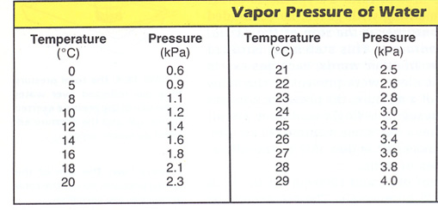
Collecting Gases over Water
It is common to synthesize gases and collect them by displacing a volume of water.
Zn + 2 HCl → H₂ + Zn⁺² + 2 Cl⁻
The pressure of H₂O depends
on the temperature of the H₂O

Slide 18
Kinetic Molecular Theory (KMT)
Developed to explain the behavior of gases:
1) Particles are small especially compared to the volume they occupy (volume is negligible)
2) Particles are in constant random motion with collisions on the wall called pressure
3) Particles exert forces on one another (elastic collisions!) but are not attracted or repelled by each other
4) Average KE of gas particles is proportional to temperature.

Slide 19
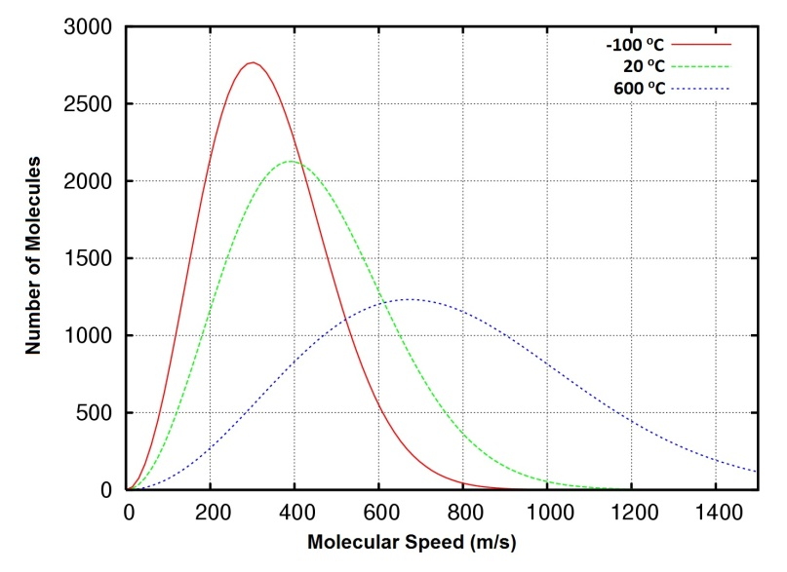
Gives us an understanding of pressure and temperature on the molecular level.
Pressure of a gas results from collisions with each other and wall of container
Magnitude of pressure is determined by how often and how hard the collisions are
Kelvin temperature indicates the average KE of the gas particles
Some molecules have less
KE or more KE then the
average (distribution)

Slide 20
At a given T, all ideal gas molecules (regardless of identify and mass) will have the SAME average KE.
Measuring the temperature of the gas also measures the average KE of the molecules
where R = 8.3145 J/mol K
This equation show that changes in KE are directly related to T and vice versa.

Slide 21
Root Mean Square Velocity
As the KE increases, the velocity of the gas molecules increases.
Average velocity of a gas particle is a special kind of average
Root mean square (rms) speed, u_{rms}, is the speed of a gas molecule having average KE
where m = mass of the molecule
(derived from KE = ½ mv²)

Slide 22
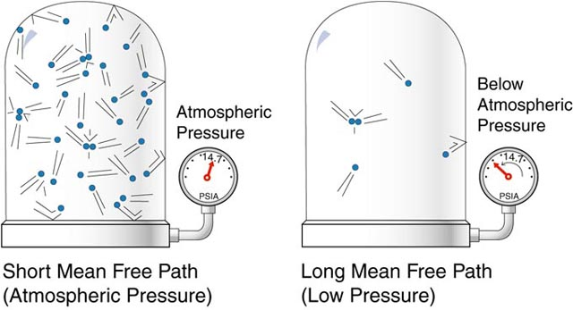
Mean Free Path
The average distance a particle travels between collisions in a sample of gas
As particles collide they produce a large range of velocities
As temperature increases, KE increases and so do the relative number of gas particles at high velocities

Slide 23
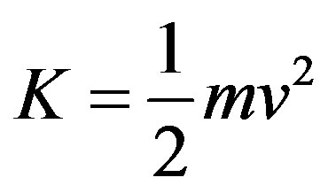
Effusion and Diffusion
The avg. KE of a gas is related to its mass:
If two gases are at the same temperature, the lighter gas will have a higher rms speed than the heavier gas
The lower the molar mass (M), the higher the rms speed for that gas at a constant temperature.
Effusion and Diffusion are dependent on molecular speeds.

Slide 24
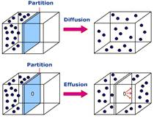
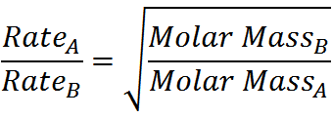
Diffusion – mixing gases; the spread of one substance throughout a space
Effusion – passage of a gas through a tiny orifice into an evacuated chamber
Graham’s Law of Effusion
The relative rates of effusion of two gases at the same T and P are given by the inverse ratio of the square roots of the masses of the gas particles

Slide 25
During effusion, only those molecules which hit the small hole will escape through it
The higher the rms speed the more likely it is that a gas molecule will hit the hole
Diffusion is faster for light gas molecules
Slows down the rms speed due to collisions (mean free path)

Slide 26
Real Gases
No gas exactly follows the ideal gas law
Gases behave most ideally at LOW pressures and/or HIGH temperatures
As pressure decreases, molecules are able to spread out→ Space where molecules can move gets larger → Weaker IMF since farther apart→ Closer to ideal gas behavior
As temperature increases, more energy is available to break IMF → Closer to ideal gas behavior

Slide 27
Van der Waals Equation
The behavior of a REAL gas, causes deviation from the ideal gas equation:
Pressure – decreased due to the actual attractions between gas particles that will establish curved paths, making collisions with the walls less frequently
Volume – increased due to space that is assumed empty but is actually occupied by moles of gas

Slide 28
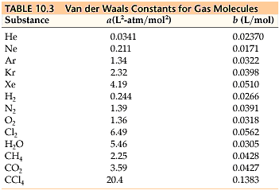
a and b are empirical constants that differ for each gas
Volume - gas at low pressure or
large volume, space is much larger
than the gas particles themselves
and gases behave ideally
Temperature – gas at high temp are moving so quickly that they have very few interactions and so there is little effect on pressure

